Slide 2
Building a voice assistant in .NET
Sanjar Akhmedov

Slide 3



About me
Full Name: Sanjar Akhmedov
Position: Software Engineer
Company: SilkRoadProfessionals
Years of Experience: 3
/Akhmedov_Sanjar
/Akhmedov_Sanjar
/SanjarSoftdev

Slide 4
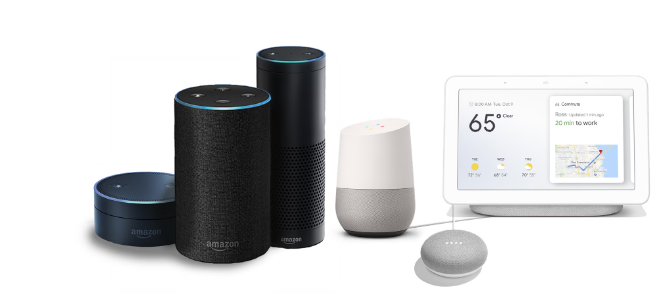
What is Voice Assistant?

Slide 5

Everyday Benefits of Voice Assistants
Home Automation
Task Management and Scheduling
Voice-Powered Accessibility

Slide 6




Voice assistant in .NET
Speech Recognition
NLP Processing
Action Execution
Response Generation

Slide 7
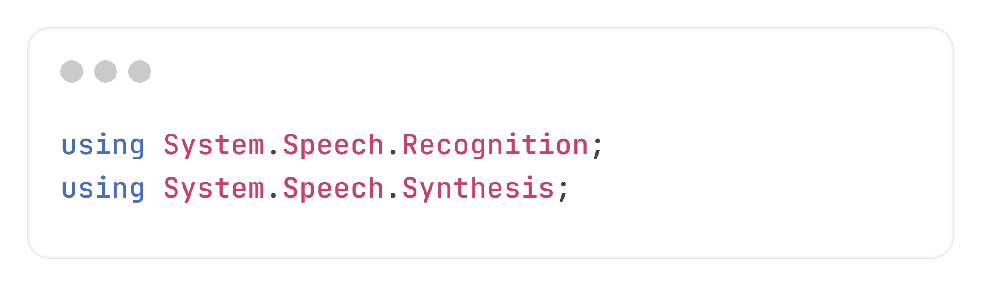
Introduction to System.Speech Library

Slide 8
Basic speech recognition setup
Initialization
Set Up the Input Source
Grammar Definition
Event Handling
Start Recognition

Slide 9
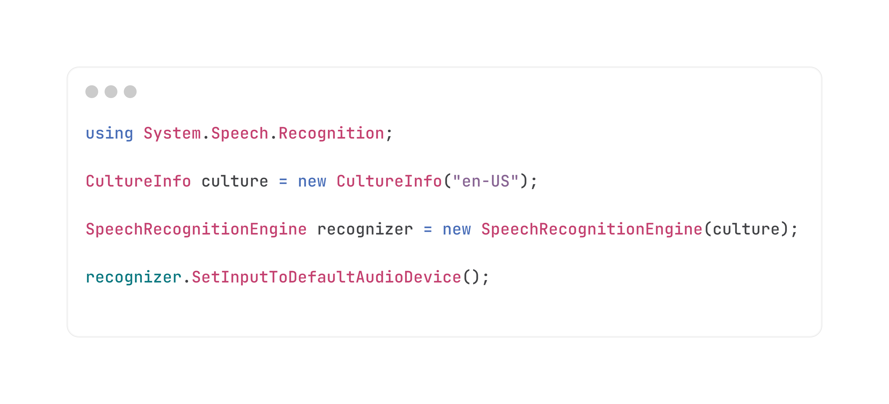
Initialization and set up input source

Slide 10
Importance of Grammar
Dictation grammar (for free-form speech)
Predefined grammar (like command-and-control grammars)

Slide 11
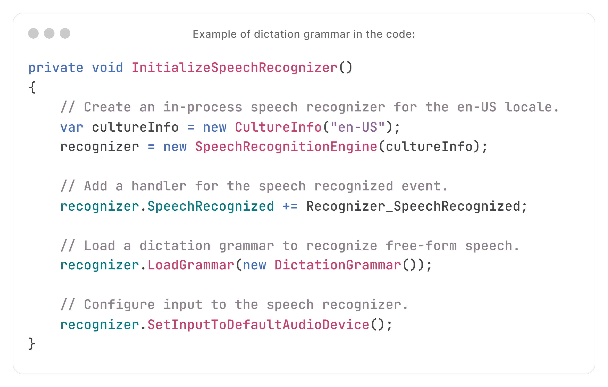

Slide 12
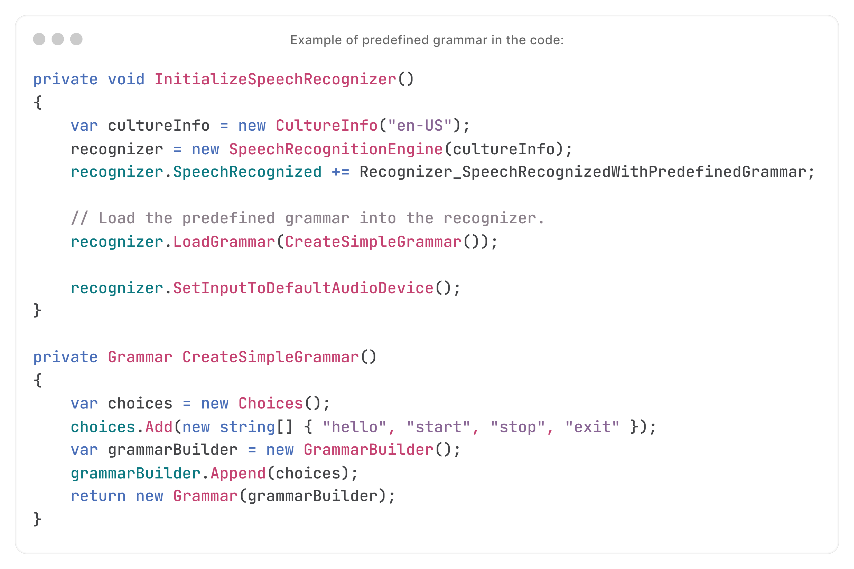

Slide 13
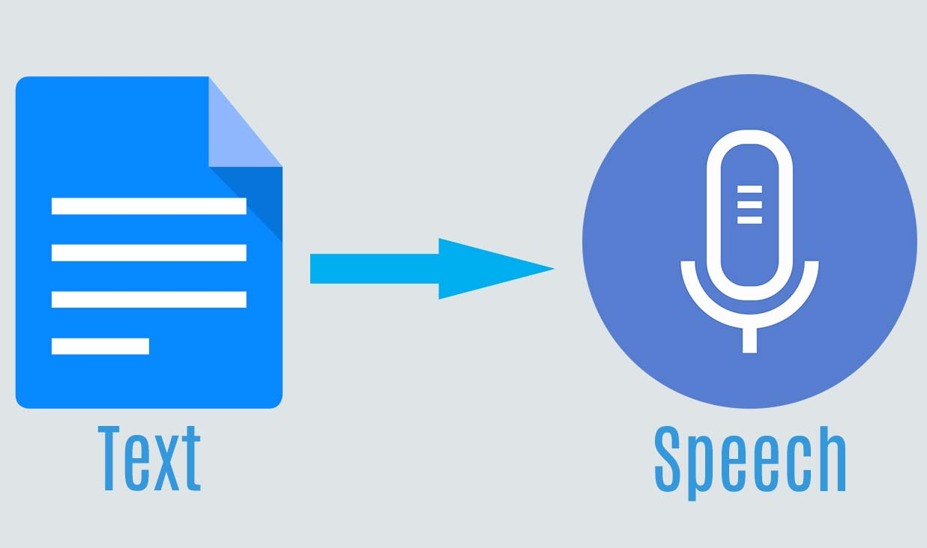
Introduction to Speech Synthesizer

Slide 14
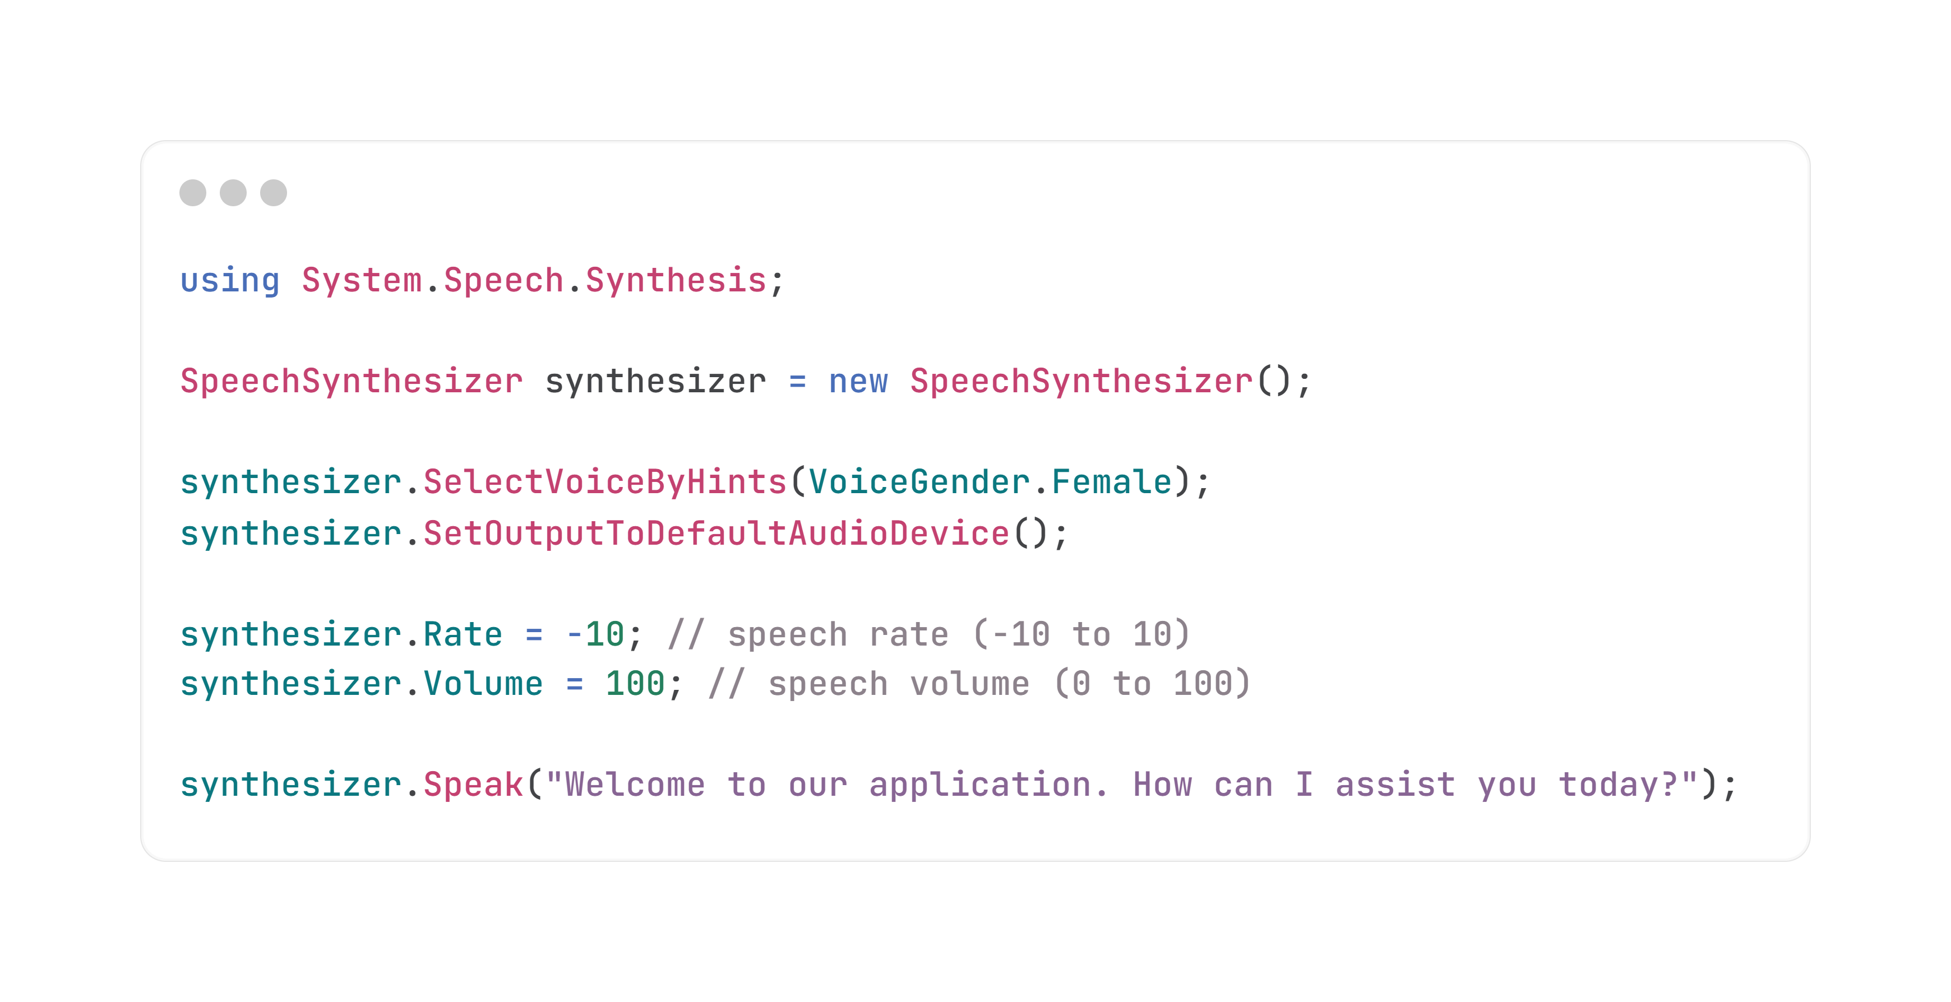
Basic speech synthesizer setup

Slide 15
Demo

Slide 16
Thank you!

